Slide 1
More Personal Computing Windows 10 Developer Workshop

Slide 2
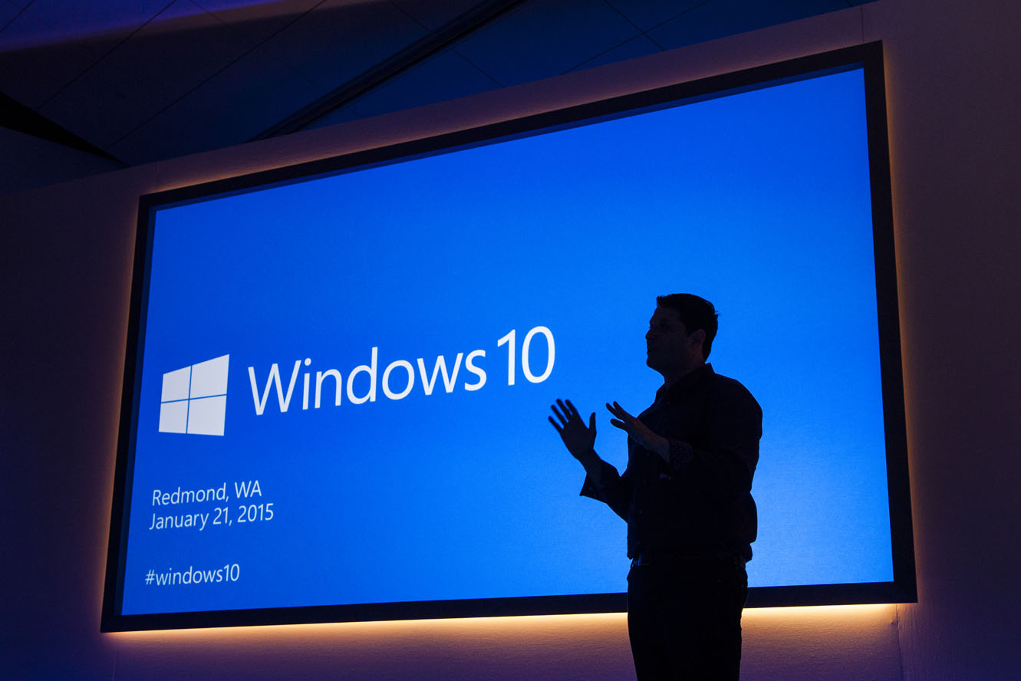
“Windows 10 is the first step to an era of more personal computing”
Terry Myerson
Notes:
Mobile first, cloud first helps us understand what happens when devices and the cloud are operating at scale together. More Personal Computing helps us think about how our interactions with our computers should evolve so that we can get more done, more quickly.
Kinect for Xbox One is a great example of a computer and an operating system that is natural and sensor aware. When you enter the room, the Kinect sees you, recognizes you, logs you in and asks you if you wish to engage. With your voice, or with gesture, or with a game controller, you can start a movie, play a game or even start up a Skype conversation. In Windows 7 and 8, Kinect for Windows brought a lot of this capability to the PC at an application level… with Windows 10, we are starting to enable this into the core operating system.
As we move into the future, our computers will do more. They will have sensors so they can start seeing the real world, they’ll use the cloud to help them understand what they’re observing, and we’re changing how we engage with them, and also how they interact with us.
We’re at start of something new and special..
While this is a different kind of computing, the reason we compute has never changed. We use computers to make the most of our precious time.
The idea behind more personal computing was whether we could add something new to how we work with our computers. What If we could engage them as naturally we can engage each other, maybe we could get stuff done faster, so we could spend more time doing whatever matters most to us.“

Slide 3

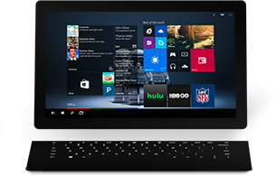
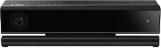
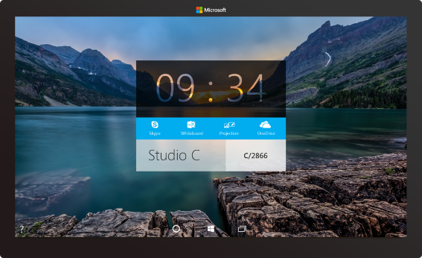
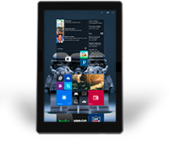

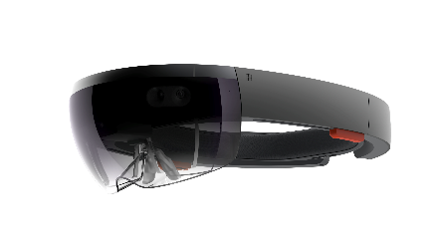



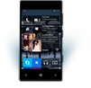
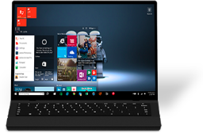
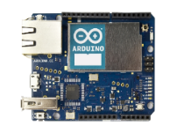

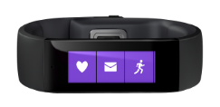
The Windows 10 family of devices
Notes:
“Windows 10 brings the technologies in more personal computing to the full breadth of Windows 10 devices.
As just one example, Cortana’s voice recognition and natural language interaction is found in devices as varied as Windows Phone, Xbox One, Surface, laptops and convertibles from our OEM partners, our giant Surface Hub screens, the Microsoft Band. And regardless of which device you’re using, Cortana knows to pick up your conversation just where you left off when you were last talking.
All Windows 10 devices share the Windows Core, and they all run Windows 10 UWP apps. For developers, there’s a single Windows store, so their app experiences can be fully mobile across all the devices users have, powered by the more personal computing found in Windows 10.
Not just Windows, we are doing a lot of work to enable this through out everthing with ML and Project Oxford

Slide 4

Gesture
Identity
Speech
Ink
human technologies

Slide 5
Gesture

Slide 6

You
can’t
touch
this
Notes:
Touch has been available

Slide 7
I
can
touch
this
Notes:
Touch has been available

Slide 8
Gesture
Identity
Speech
Ink
human technologies

Slide 9
Identity

Slide 10
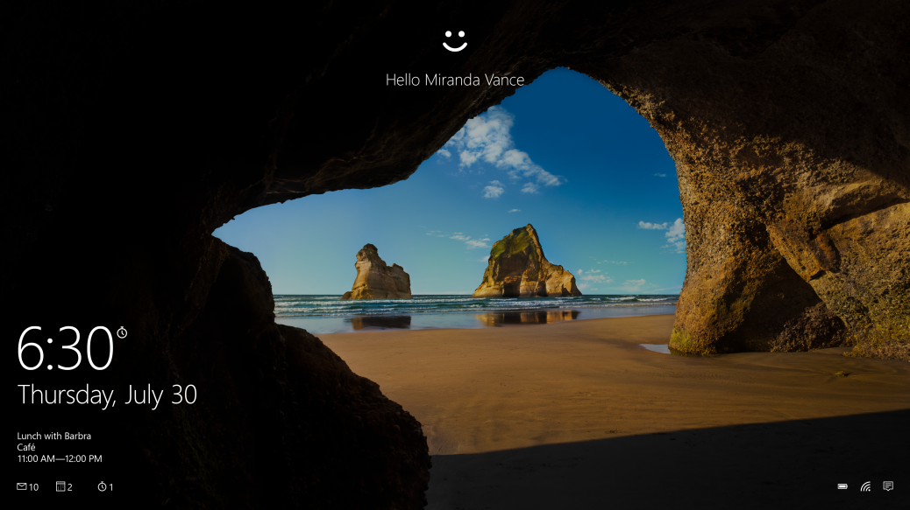
More secure, password-free experience, powered by Windows Hello and Passport
Windows Hello
Biometric authentication (face, iris, fingerprint)
Convenient, Consistent
Enterprise level security
Passport
More secure
Simplifies authentication through single “unlock gesture”
Just works Azure Active Directory services
Access to major SaaS services
Office 365 Exchange Online, Salesforce, Citrix, Box, Concur,
Notes:
What the audience should learn from this slide:
The human technologies that make more personal computing a reality are in the Windows Core and available to developers and device manufactures in Windows 10
We expect to see more personal computing in devices in all shapes and sizes with Windows 10
Suggested amount of time to present this slide:
And now we’ll run a short video on Windows Hello and Passport….

Slide 11
Gesture
Identity
Speech
Ink
human technologies

Slide 12
Speech

Slide 13

Speech Recognition and Synthesis done easy
Use SpeechRecognizer for continuous or one time recognition
Use SpeechSynthesizer for speaking back

Slide 14
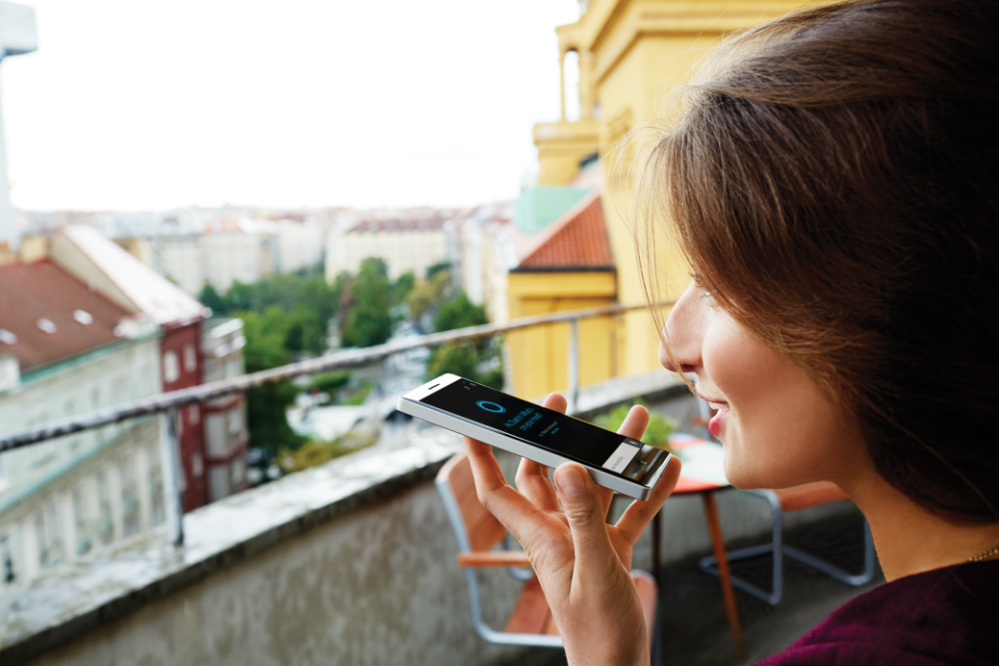
Cortana
Teach Cortana to use your app on my behalf and
contextually activate your app
retrieve information or execute an action
without loosing focus

Slide 15
Lab: Hey Cortana
Notes:
Demo of Todo application and implementation of InkCanvas and InkPresenter
Show properties, show InkToolbar
Show recognition

Slide 16
Gesture
Identity
Speech
Ink
human technologies

Slide 17
Ink

Slide 18

Writing is human
Notes:
Immediate
Expressive
Personal

Slide 19
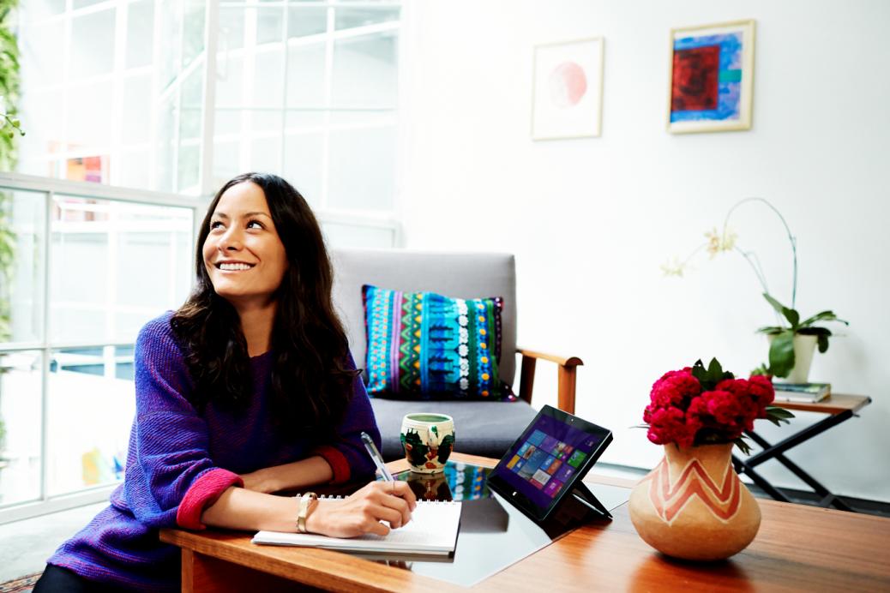
DirectInk: New ink platform for Windows apps
Inking Support on PC, Tablet & Phone
Renders beautiful ink with low-latency
Improved Comfort and Confidence
Easy to use building blocks for apps
Configure for different input types (Pen, Touch, Mouse, etc.)
Change Drawing Attributes
Manage Ink Stroke Data
Access more customization options

Slide 20
Lab: Working with Ink Input
Notes:
Demo of Todo application and implementation of InkCanvas and InkPresenter
Show properties, show InkToolbar
Show recognition

